Slide 1



DATA SCIENCE ACADEMY
CAPSTONE PROJECT
RIDE HAILING
INTERNET PACKAGE
GROUP 12
Yustinus Kunta Wibisana
Shelby Marsa Istiqomah
Wahyu Sejati Roso
Rizaldy Al Kautsar Utomo

Slide 2

CRISP-DM
RIDE-HAILING INTERNET PACKAGE
1
Business Understanding
4
Modelling
Understand objective and requirement from business perspective
Building the model for desired output
2
Data Understanding
5
Evaluation
Getting familiar with the data to form hypotheses
Assess the quality of the model based on requirement
3
Data Preparation
6
Deployment
Construct dataset from raw data
Put the result to work and achieve the goals

Slide 3
BUSINESS
UNDERSTANDING

Slide 4
Ride-Hailing is multi billion business in Indonesia, and the driver stand as partner which plays crucial role, represent 0.9% of Telkomsel Population
Gojek drivers as a partner contribute to IDR 8 Trillion annually (2018)
34% of them have monthly income of > IDR 3.5 million after joined as ride hailing driver, only 8% of them already have it before join as a partner
Serving
Active Ride-Hailing Drivers
Active Ride-Hailing Users
Driver to Consumer Ratio
1:11
1.48 Million
16.86 Million
Daily income of IDR 150-200k/day, communication expense can be a burden if Telco company don’t provide the best offering
*Telkomsel MSIGHT January 2020 Data
** Lembaga Demografi FEB UI (2018)

Slide 5
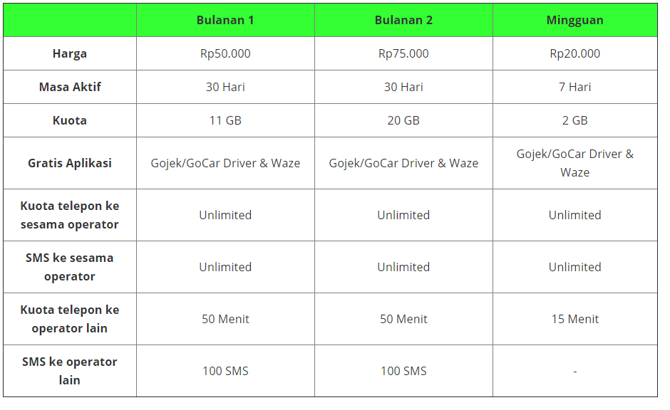
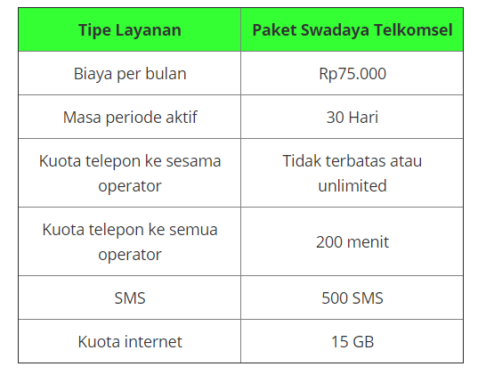
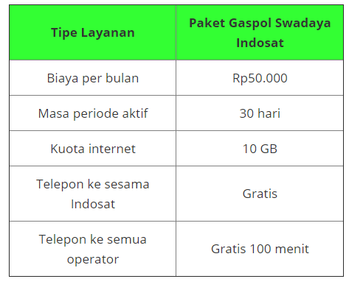
Telkomsel as connectivity provider stand as enabler to make the driver experience with ride-hailing app more seamless
XL
Telkomsel
Indosat
Price/GB
IDR 3750
Price/GB
IDR 5000
Price/GB
IDR 5000
Telkomsel has several competitor with more competitive price for ride-hailing driver package. We need to enhance value proposition to improve the takers of package

Slide 6




There are several key application that relate to ride-hailing jobs, competitor already offers free-quota access for core app
CORE
SUPPORTING
Communication
Entertainment
Social Media
Ride-Hailing App
Navigation App
Games

Slide 7
Understanding driver needs and usage of connectivity with data science can be the key to drive more takers in Ride-Hailing package
Driver Workflow
Internet Data Access
Balanced transport supply-demand
CORE APP
Legacy Communication (SMS & Voice)
Service Excellence
Connectivity
SUPPORTING APP
Productivity
Boost Economic Growth
Data Collection
Package Offering
A
Prediction of package takers
1
Assessing Driver’s need of connectivity based on historical data
2
Understand package takers behaviour
New opportunity of package pricing based on segment (cluster)
Data Science Modelling
B
Telkomsel’s Business Opportunity

Slide 8
… based on previous business problem, 3 objective and key result can be derived wuith data science process (classification & clustering)
Problem Statement
Objective
Telkomsel already have ride-hailing package for drivers, priced at IDR 75k/month.
The package are targeted for whitelisted MSISDN, as October’19 there are 1.74 mio of whitelist with 559k takers (32%)
1
Build supervised model that can predict takers
2
Create segment of customer with clustering
3
Develop subsegment based on ARPU
Key Result
1
Achieve 80% Area Under the Curve (AUC) and 70% F1-Score
2
….
3
….

Slide 9
… to achieve the result, expected timeline is 2 months of CRISP-DM complete cycle
W2 Feb | W3 Feb | W4 Feb | W1 Mar | W2 Mar | W3 Mar | W4 Mar | W1 Apr
Business Understanding
Data Understanding
Data Preparation
Develop Model MVP
Evaluation & Iteration
Delivery & Deployment

Slide 10
DATA
UNDERSTANDING

Slide 11
DATA
PREPARATION

Slide 12
MODELLING

Slide 13
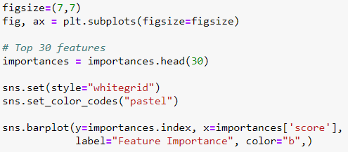
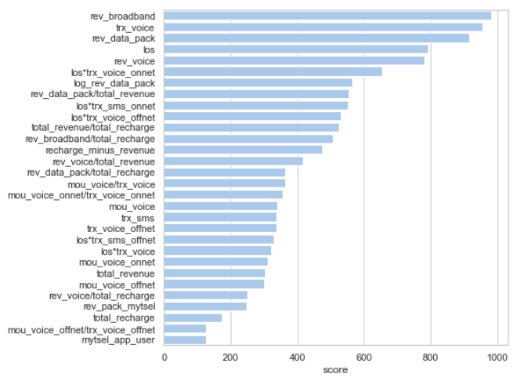
30 top feature ingested into the model, feature selection conducted using XGBoost algorithm
Revenue of data usage (rev_broadband & rev_data_pack) managed to get into top 3
Feature that created from feature engineering managed to have high score

Slide 14
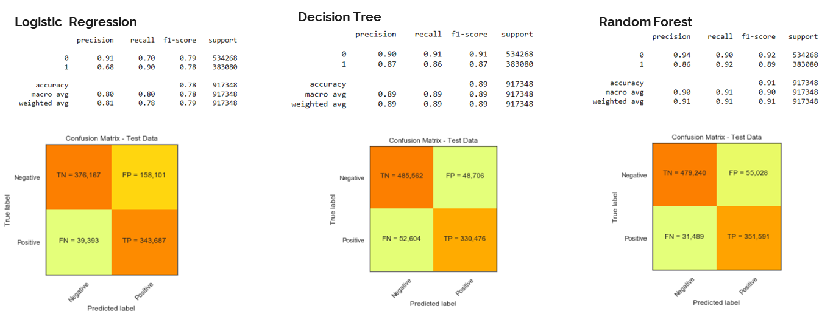
For 1st Objective (Classification), Random Forest achieved highest score, compared to Logistic Regression and Decision Tree
F1 Score= 79%
F1 Score= 89%
F1 Score= 91%
All algorithm managed to achieve key result of F1-Score above 70%, we decided to went with Random Forest that managed to have high precision and recall resulting with high F1-Score (91%)

Slide 15
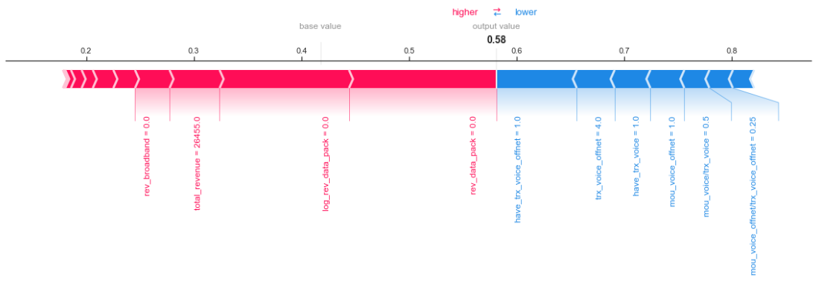
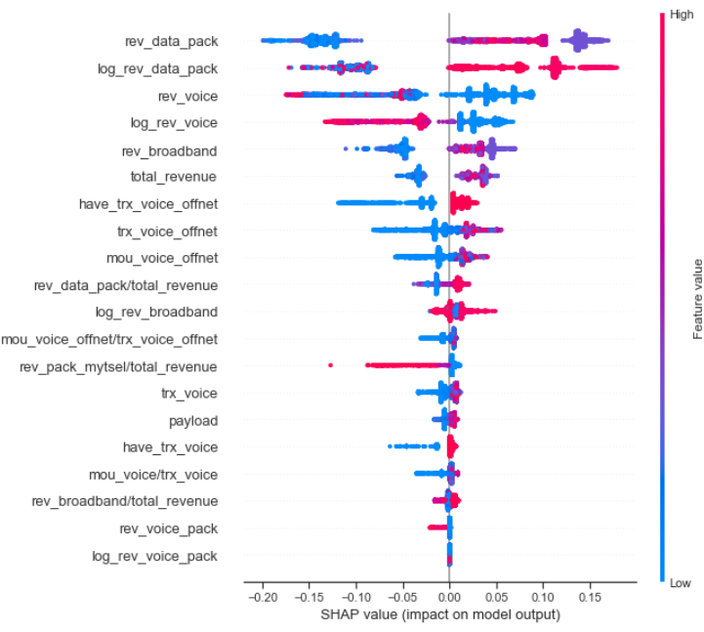
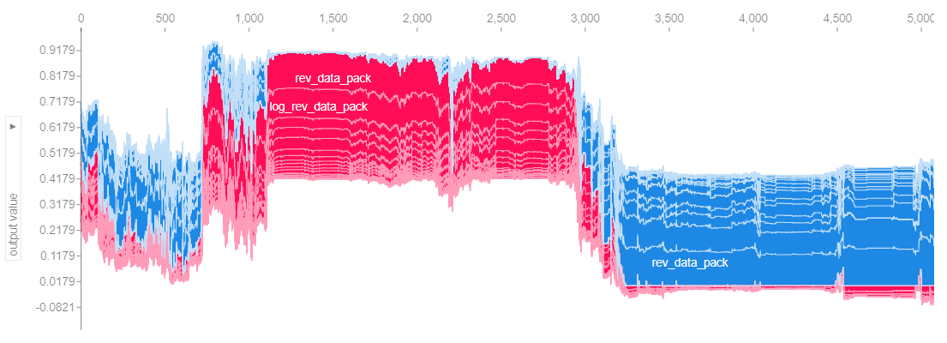
SHAP Value also determined that data_package is the most important feature, followed by voice

Slide 16
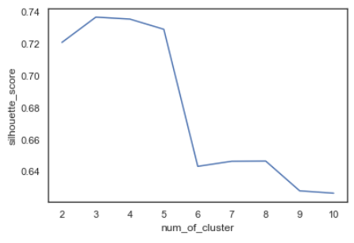
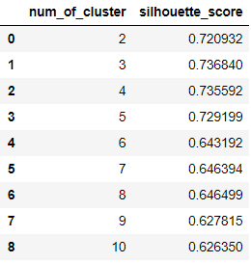
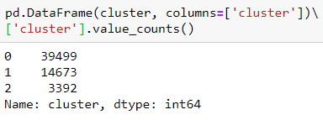
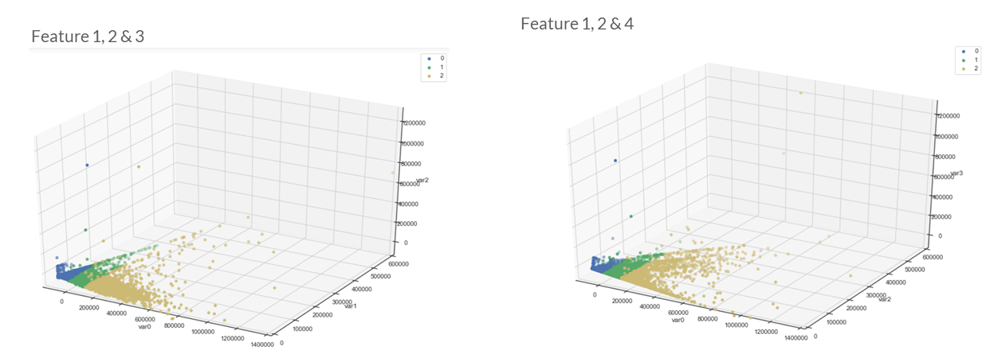
For 2nd Objective (Clustering), silhouette score is used to determine number of cluster. The optimal number of cluster is 3
Total MSISDN in each cluster
Determining number of cluser
Cluster seems have consistent grouping (not underfit/overfit) based on 3D visualization.
Cluster 1 have the largest number of MSISDN (39k), followed by cluster 2 (14k) and cluster 3 (3k)
3D Cluster Visualization using PCA Analysis

Slide 17
EVALUATION

Slide 18
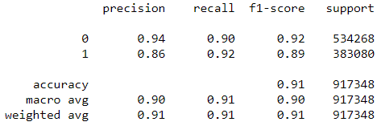
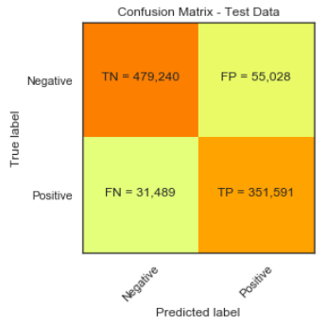
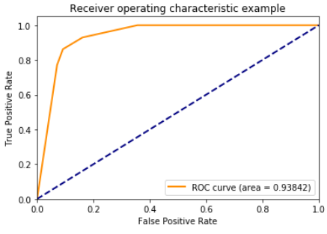
Random Forest successfully meet the 1st objective for classification with 93.8% of AUC and 91% of F1-Score
There are potential 55k new numbers of takers based on this algorithm. In total there are 406k potential package takers.
44.2% taker rate, uplift +14% from previous data

Slide 19
For the 2nd Objective, there are 3 main cluster with different behaviour and usage, resulting in different package price
Low Transaction
39.4k subs
IDR 86k
14 GB
Potential Customer
14.6k subs
IDR 164k
24 GB
Data Addict
3.39k subs
IDR 287k
43 GB

Slide 20
For the 3rd Objective, main cluster derived into each 3 sub-cluster each, resulting in 7 different sub-cluster
Lower ARPU (< IDR 150k)
Middle ARPU (IDR 150k – IDR 250k)
Top ARPU (>IDR 250k)
Low Transaction
39.3k subs
IDR 86k
14 GB
180 subs
IDR 166k
16 GB
Potential Customer
2139 subs
IDR 133k
20 GB
12.4k subs
IDR 168k
25 GB
108 subs
IDR 296k
25 GB
Data Addict
1314 subs
IDR 232k
38 GB
2078 subs
IDR 323k
46 GB

Slide 21
DEPLOYMENT

Slide 22
